Slide 1
Transfer Learning
Prof. Dr. Umberto Michelucci
umberto.michelucci@toelt.ai
umberto.Michelucci@hslu.ch

Slide 2
Biggest trick in computer vision and deep learning

Slide 3
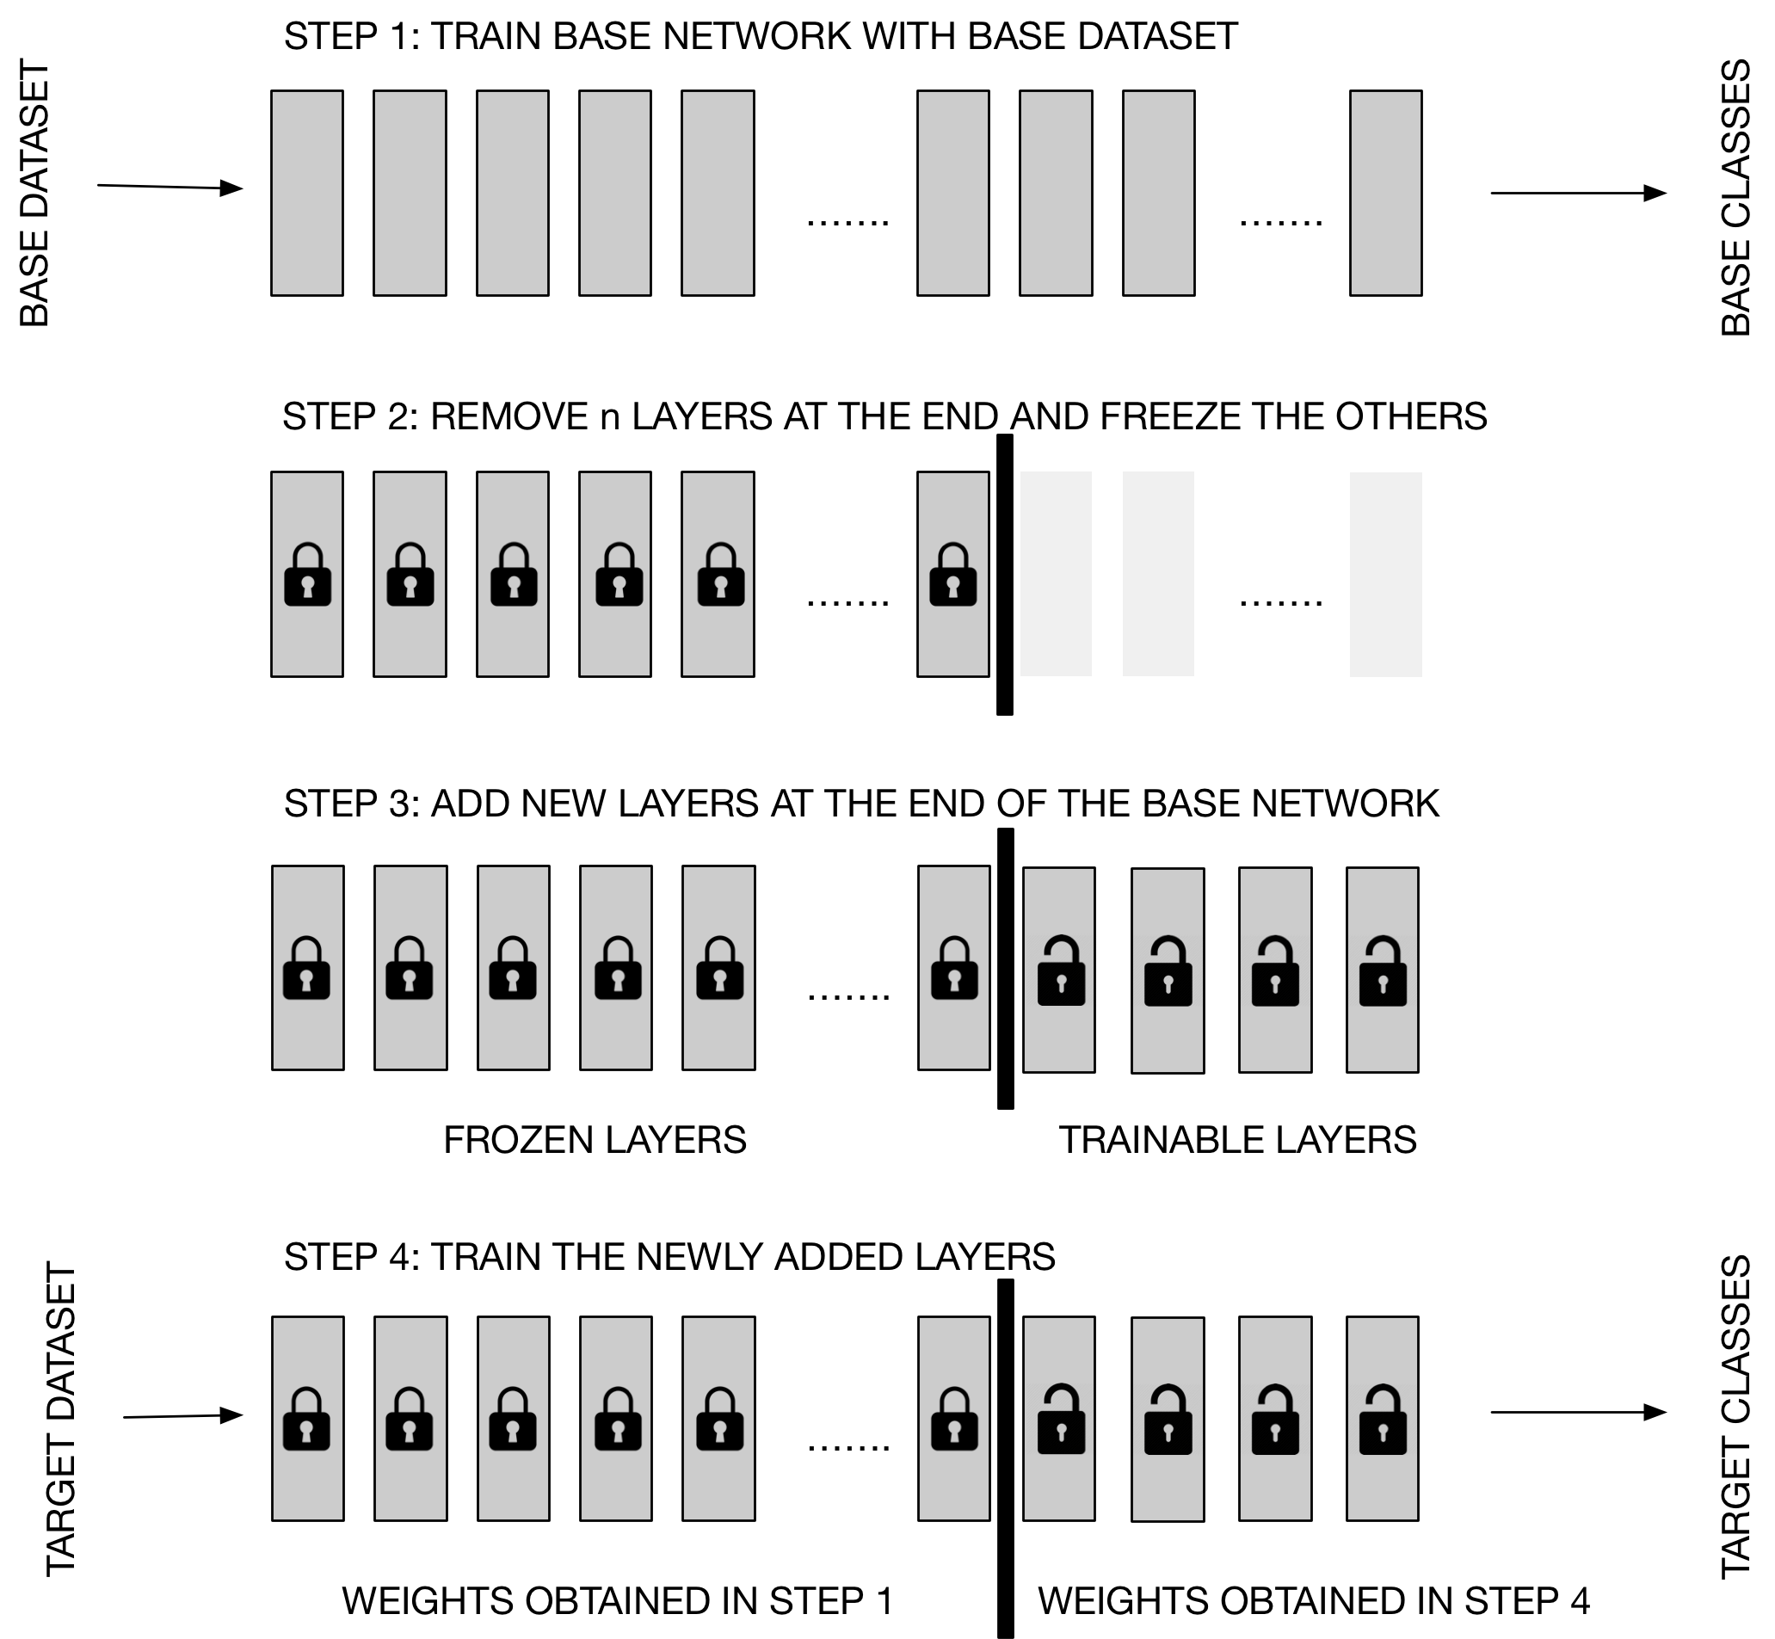
Transfer Learning
Step 1
Step 2
Step 3
In this approach, the entire network has to be trained several times (to tune the hyperparameters). This can be slow.
Step 4
Quelle: Michelucci, U. (2019). Advanced applied deep learning: convolutional neural networks and object detection. Apress.

Slide 4
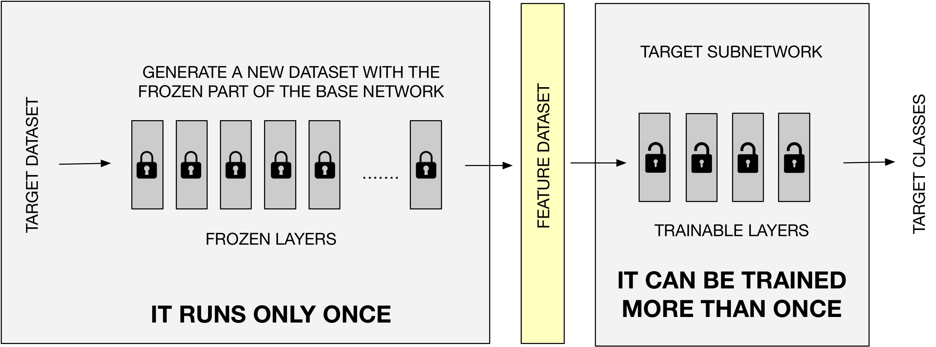
We can make transfer learning more efficient.
Quelle: Michelucci, U. (2019). Advanced applied deep learning: convolutional neural networks and object detection. Apress.

Slide 5
A few numbers (how to become more efficient)
Approach 1 (Naïve)
Approach 2 (Smart)
1 EPOCH → 4.5 minutes
1 EPOCH → 6 seconds
100 EPOCH → 7.5 hours
100 EPOCH → 10 minutes
The numbers come from a test with a "dog/cat" image dataset of about 800 MB. All information can be found in Michelucci, U. (2019). Advanced applied deep learning: convolutional neural networks and object detection. Apress.

